Slide 1

Data Science
CSC 495/663

Slide 2
Git
What is Git?
Distributed Version / Revision Control System
Large projects – Multiple members/coders
Software development
Decentralized, Fast, Flexible
Git Servers
GitHub (https://education.github.com/pack)
We are going to be using GitHub – Get an account
BitBucket (https://www.atlassian.com/software/views/bitbucket-academic-license.jsp)
….
Git Tools
Command line git
Tower, Github (windows, mac), Gitbox, SourceTree

Slide 3
Git Setup
Windows
http://msysgit.github.io/
Mac
http://git-scm.com/download/mac
Linux
http://git-scm.com/book/en/v2/Getting-Started-Installing-Git
Guide
http://rogerdudler.github.io/git-guide/
http://slides.com/moji3000/git_presentation/fullscreen#/

Slide 4
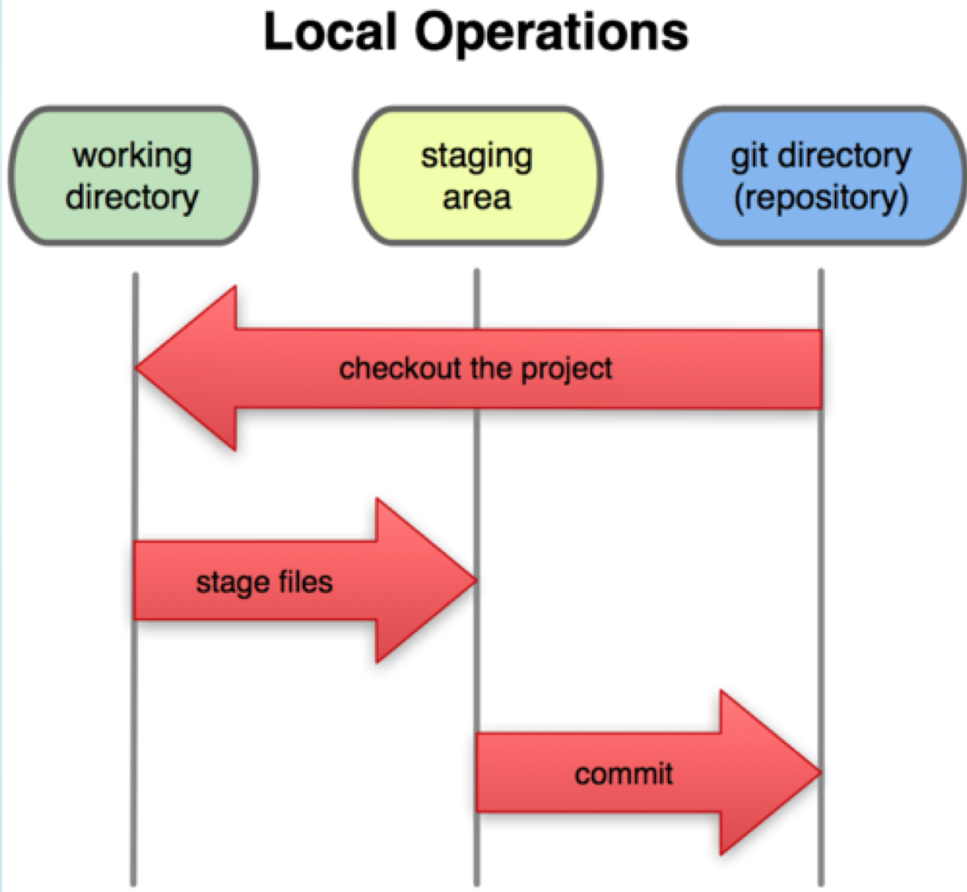
Git Setup

Slide 5
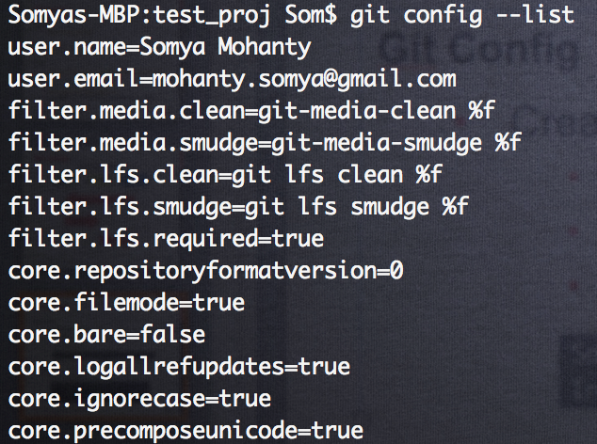
Git Setup
Git Config
Add your user name and email

Slide 6
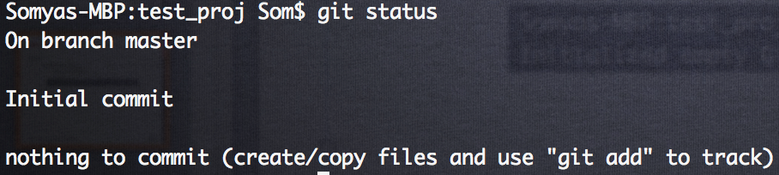
Git
Git Init
Create a new repository
Create a new directory
Open it
Execute git init
Git Status
Status of the project

Slide 7
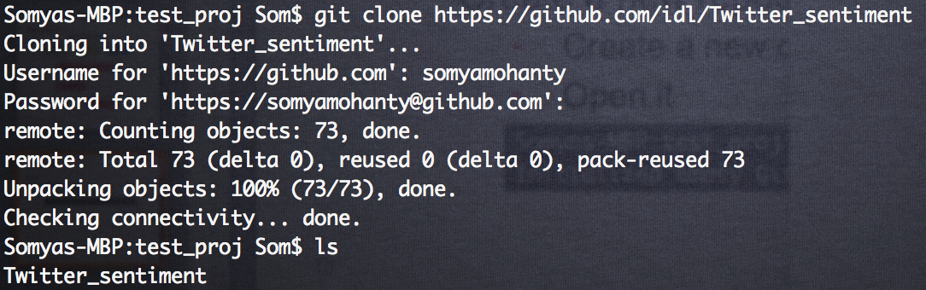
Git
Git Clone
Create a working copy from remote server

Slide 8
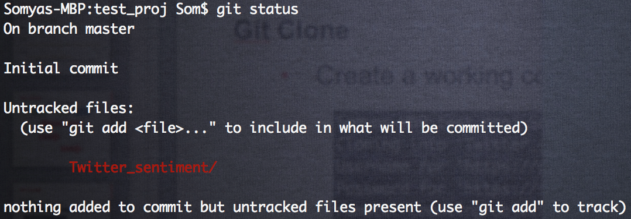
Git
Git Status
Uncommitted

Slide 9
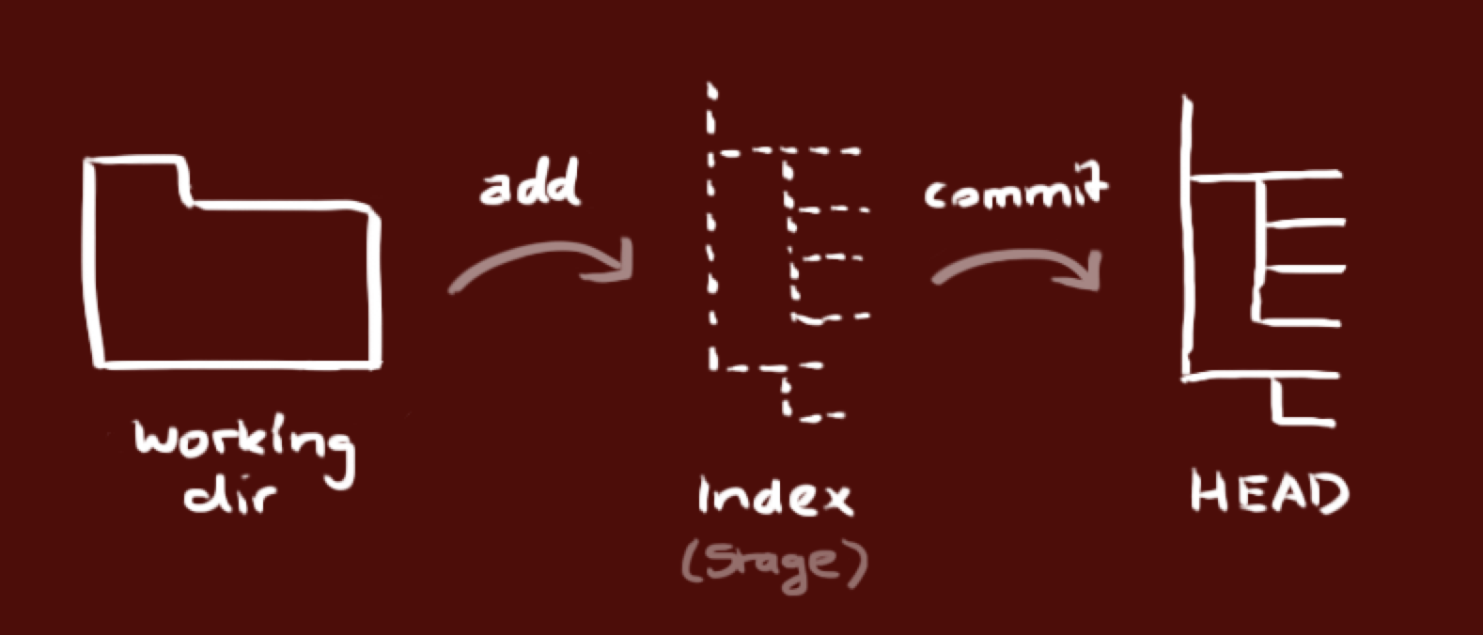
Git
Git Workflow
Working Directory - Actual Files
Index – Staging Area
Head – Commit Pointer

Slide 10
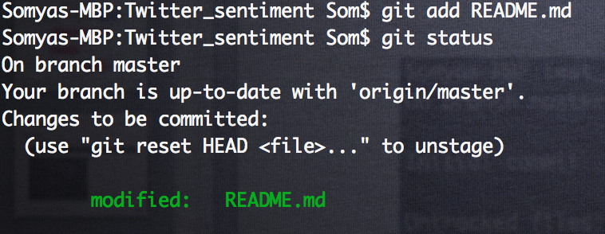
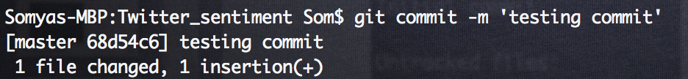
Git
Git Add
Change a file
Git Commit
Commit the changes made to a file

Slide 11
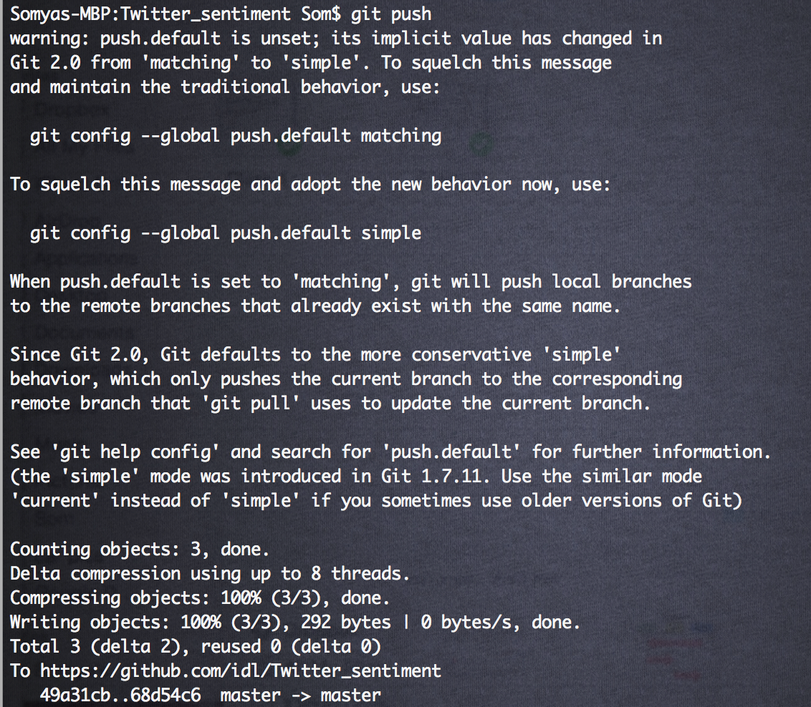
Git
Git Push
Push head to include the new commit

Slide 12
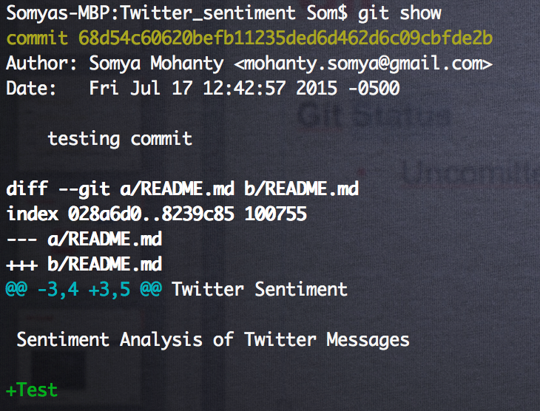
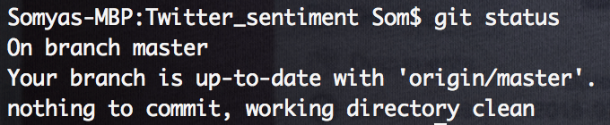
Git
Git Show

Slide 13
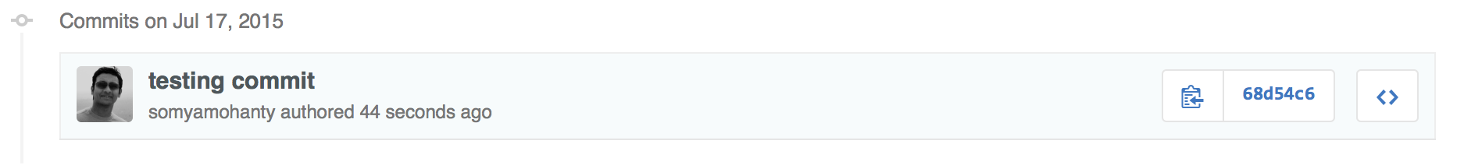
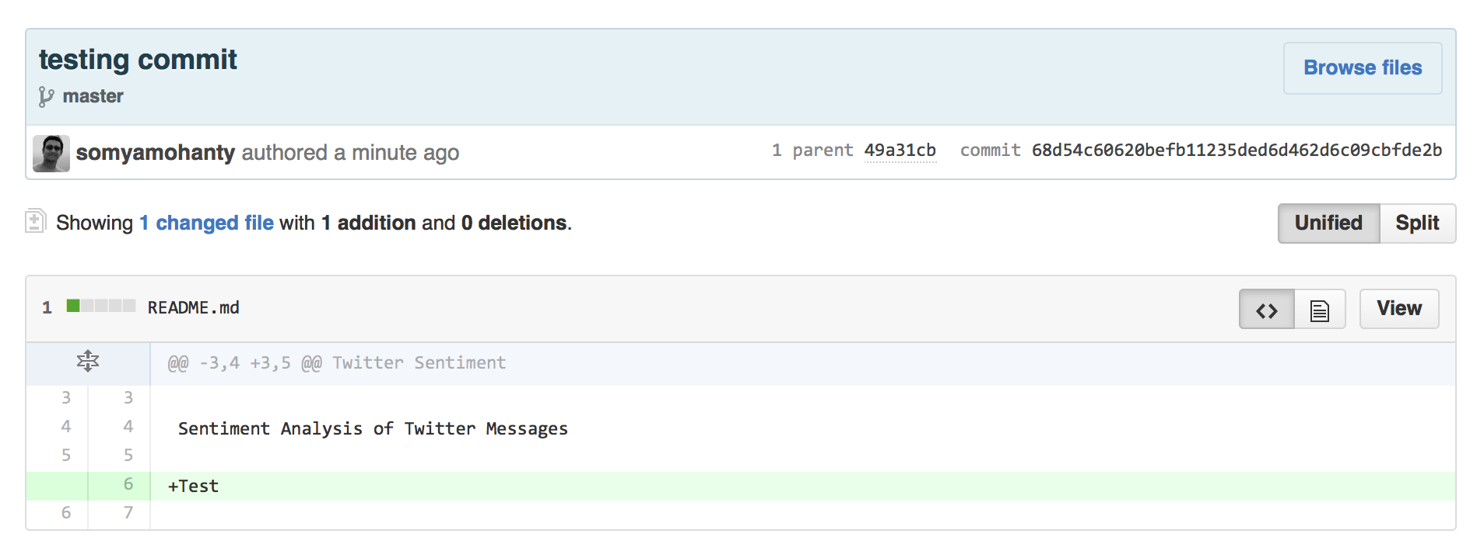
Git

Slide 14
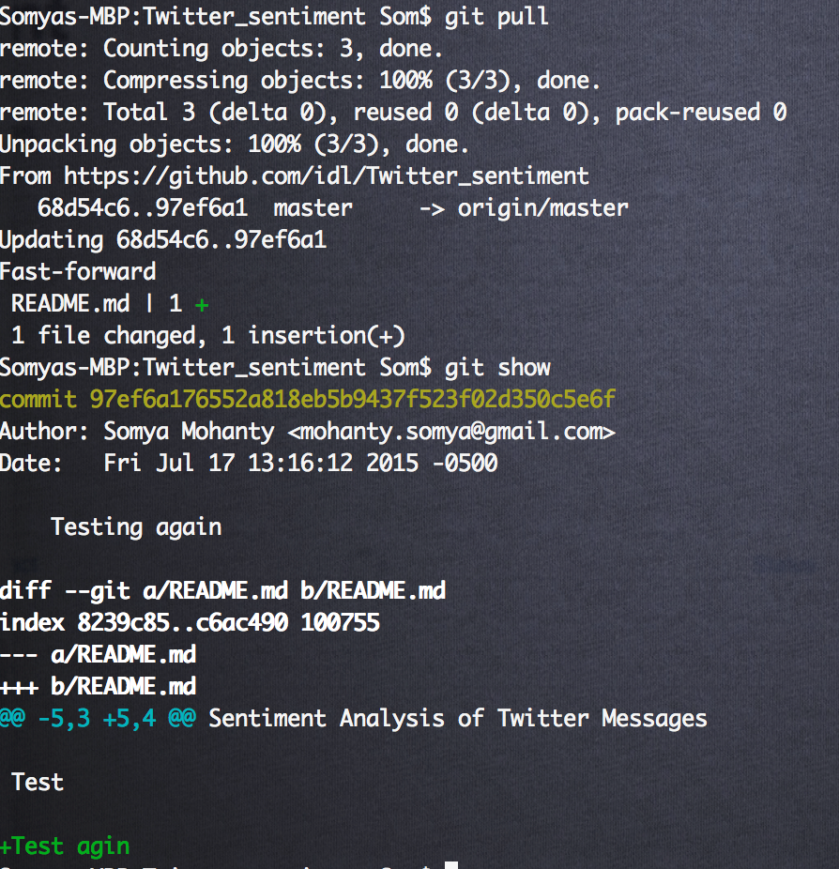
Git
Git Pull
Get new updates

Slide 15
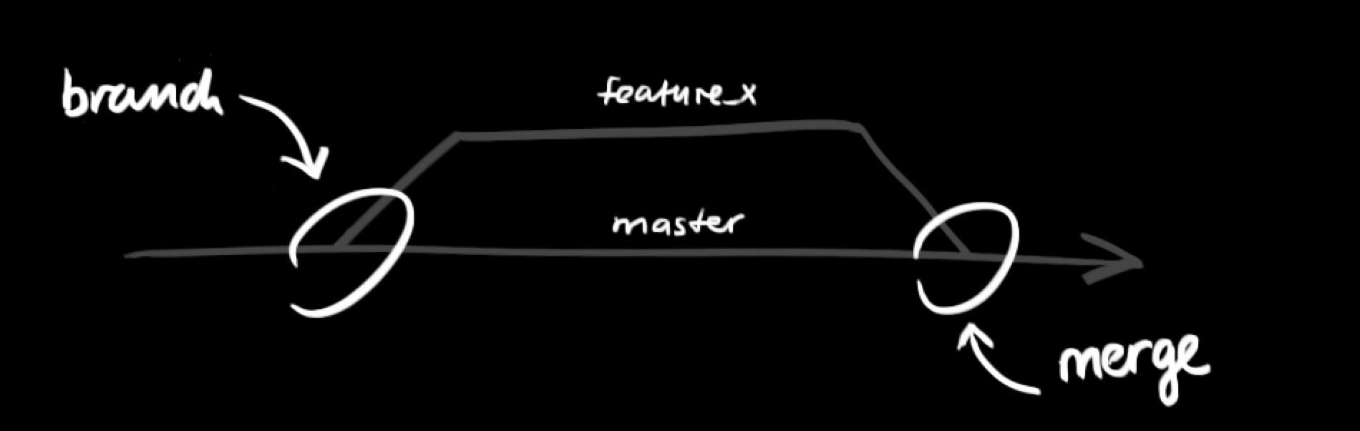
Git
Git Branch

Slide 16
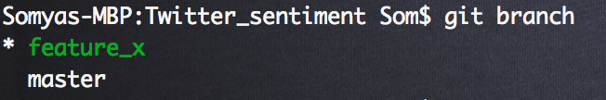
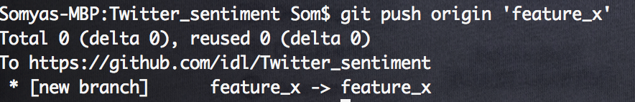
Git
Git Branch
Git push branch

Slide 17
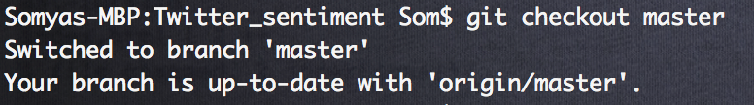
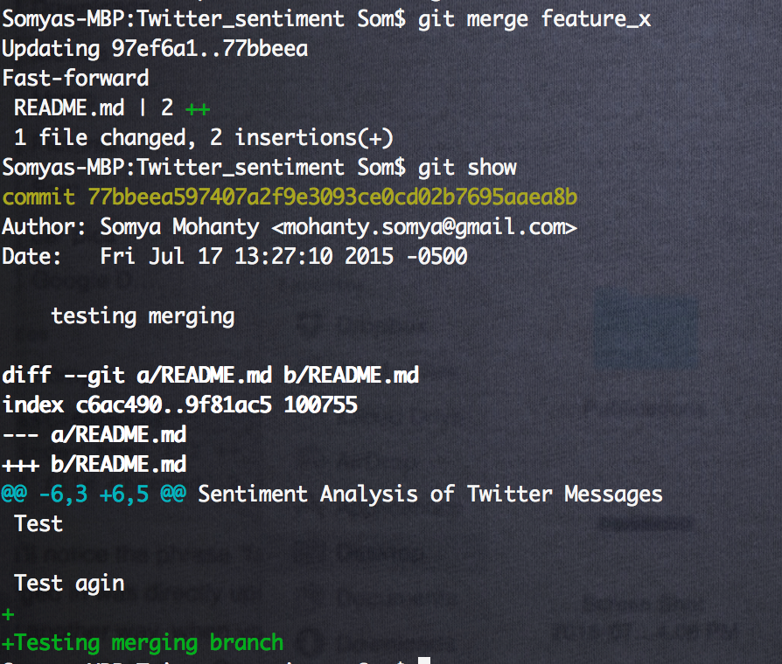
Git
Git Checkout
Git merge branch

Slide 18
Pip
What is Pip?
Package manager to install python libraries
pip install <some-package-name>
How to install pip?
Linux (ubuntu)
sudo apt-get install python-pip
Mac
sudo easy_install pip
Download get-pip.py from https://bootstrap.pypa.io/get-pip.py
Pip install
python get-pip.py --no-index --find-links=/local/copies
python get-pip.py –user
Upgrade pip
pip install -U pip

Slide 19
Virtual Environment
What is Virtual Environment?
Dependencies relevant to project
Local to projects
Easy to do pip-freeze and get the requirements
Solves “Project X depends on version 1.x but, Project Y needs 4.x”
Helps in re-producible projects
Steps
Install virtualenv and virtualenvwrapper (makes it much easier to work with virtualenv)
Linux or Mac
pip install virtualenv
pip install virtualenvwrapper
Windows
pip install virtualenvwrapper-win

Slide 20
Virtual Environment
Steps
Set your home environment
export WORKON_HOME=~/Envs
source /usr/local/bin/virtualenvwrapper.sh
Create a project directory
mkdir assignment_1
cd assignment_1
Create virtual environments
mkvirtualenv assignment_1
workon assignment_1
List all environments
lsvirtualenv
List all packages
lssitepackages
http://docs.python-guide.org/en/latest/dev/virtualenvs/

Slide 21
Virtual Environment
Get the requirements of project
Inside the project directory
pip freeze
pip freeze > requirements.txt

Slide 22
Setup
Install build dependencies
Ubuntu
sudo apt-get install python-numpy python-scipy python-matplotlib ipython ipython-notebook python-pandas python-sympy python-nose
sudo apt-get install libfreetype6-dev libpng-dev
pip install pandas, numpy, scipy, matplotlib
Mac
Use pip to install pandas, numpy, scipy, matplotlib
Install gcc
Ubuntu
sudo apt-get install gcc
Mac
brew install gcc
Install g++
Ubuntu
sudo apt-get install g++

Slide 23
Python
Why?
Wide array of libraries for most of the applications
Numerical (NumPy, Pandas)
Scientific (SciPy)
Machine Learning (Sci-Kit, PyBrain, Gensim, NLTK)
Visualization (MatplotLib, Bokeh)
Database ORM (SQLAlchemy, PyMongo)
Big Data (PySpark, HadooPy)
Easy to learn (in comparison to let say R)
Multi-Processing
Preferred language of choice for Data Scientists

Slide 24
IPython
IPython provides a rich architecture for interactive computing with:
Powerful interactive shells (terminal and Qt-based).
A browser-based notebook with support for code, rich text, mathematical expressions, inline plots and other rich media.
Support for interactive data visualization and use of GUI toolkits.
Flexible, embeddable interpreters to load into your own projects.
Easy to use, high performance tools for parallel computing.
http://ipython.org/index.html

Slide 25
Ipython Notebook
Runs code in a web-browser
Stored in a json format
Allows for code and text (MarkDown)
Has Debugger
Has Checkpoint
Sharing / Co-editing is a lot easier
Has access to all python libraries (locally imported and system installed)
All your assignments are going to be in that. ☺

Slide 26
Ipython Notebook
Installation
pip install ipython[notebook]
Install all dependencies
Run
Locally
ipython notebook
Remote Server
ipython notebook --no-browser --port=8888
Starts at home directory
http://localhost:8888/tree
.ipynb
Ipython and Python Basics

Slide 27
Current Setup
Current requirements (Installed IPython, NumPy, SciPy, Pandas)
backports.ssl-match-hostname==3.4.0.2
certifi==2015.4.28
decorator==4.0.2
funcsigs==0.4
functools32==3.2.3.post2
ipykernel==4.0.3
ipython==4.0.0
ipython-genutils==0.1.0
Jinja2==2.8
jsonschema==2.5.1
jupyter-client==4.0.0
jupyter-core==4.0.4
MarkupSafe==0.23
matplotlib==1.4.3
mistune==0.7
mock==1.3.0
nbconvert==4.0.0
nbformat==4.0.0
nose==1.3.7
notebook==4.0.2
numpy==1.9.2
pandas==0.16.2
path.py==7.6.1
pbr==1.6.0
pexpect==3.3
pickleshare==0.5
ptyprocess==0.5
Pygments==2.0.2
pyparsing==2.0.3
python-dateutil==2.4.2
pytz==2015.4
pyzmq==14.7.0
scipy==0.16.0
simplegeneric==0.8.1
six==1.9.0
terminado==0.5
tornado==4.2.1
traitlets==4.0.0
wheel==0.24.0

